Slide 1
Understanding the Hip
Kenny Miller

Slide 2
Lecture Plan
Discuss the joint and movements
The labrum and other hip injuries
Biomechanics applications
End Goal: Have a strong base understanding of the hip joint/labrum, common injuries, and biomechanics applications

Slide 3
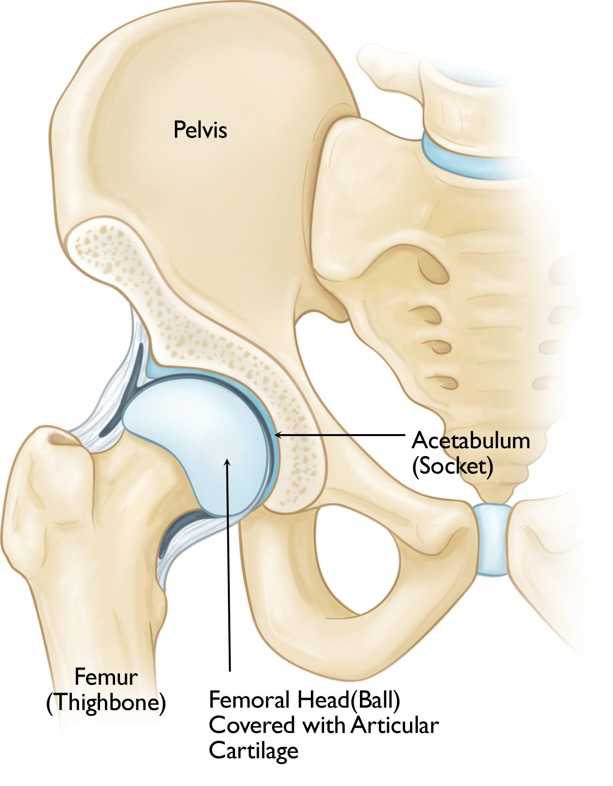
The Joint
Ball and socket joint
Connection between the pelvis and the femoral head
Designed for stability and weight bearing

Slide 4
Movements
Flexion
Extension
Abduction
Adduction
Lateral rotation
Medial rotation

Slide 5
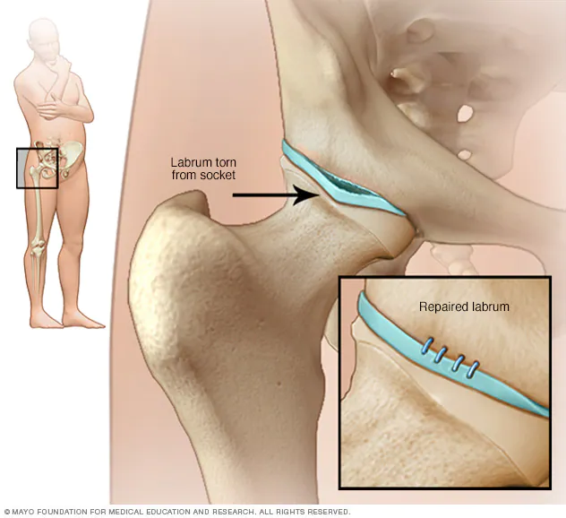
Hip Labrum
Ring of cartilage following outside rim of the hip joint socket
Cushions hip joint while acting as gasket to hold hip joint in plane

Slide 6
Injuries
Can happen to anyone at any age
Mainly happen in warm-weather and contact sports
Can be prevented using specific stretching/conditioning exercises

Slide 7
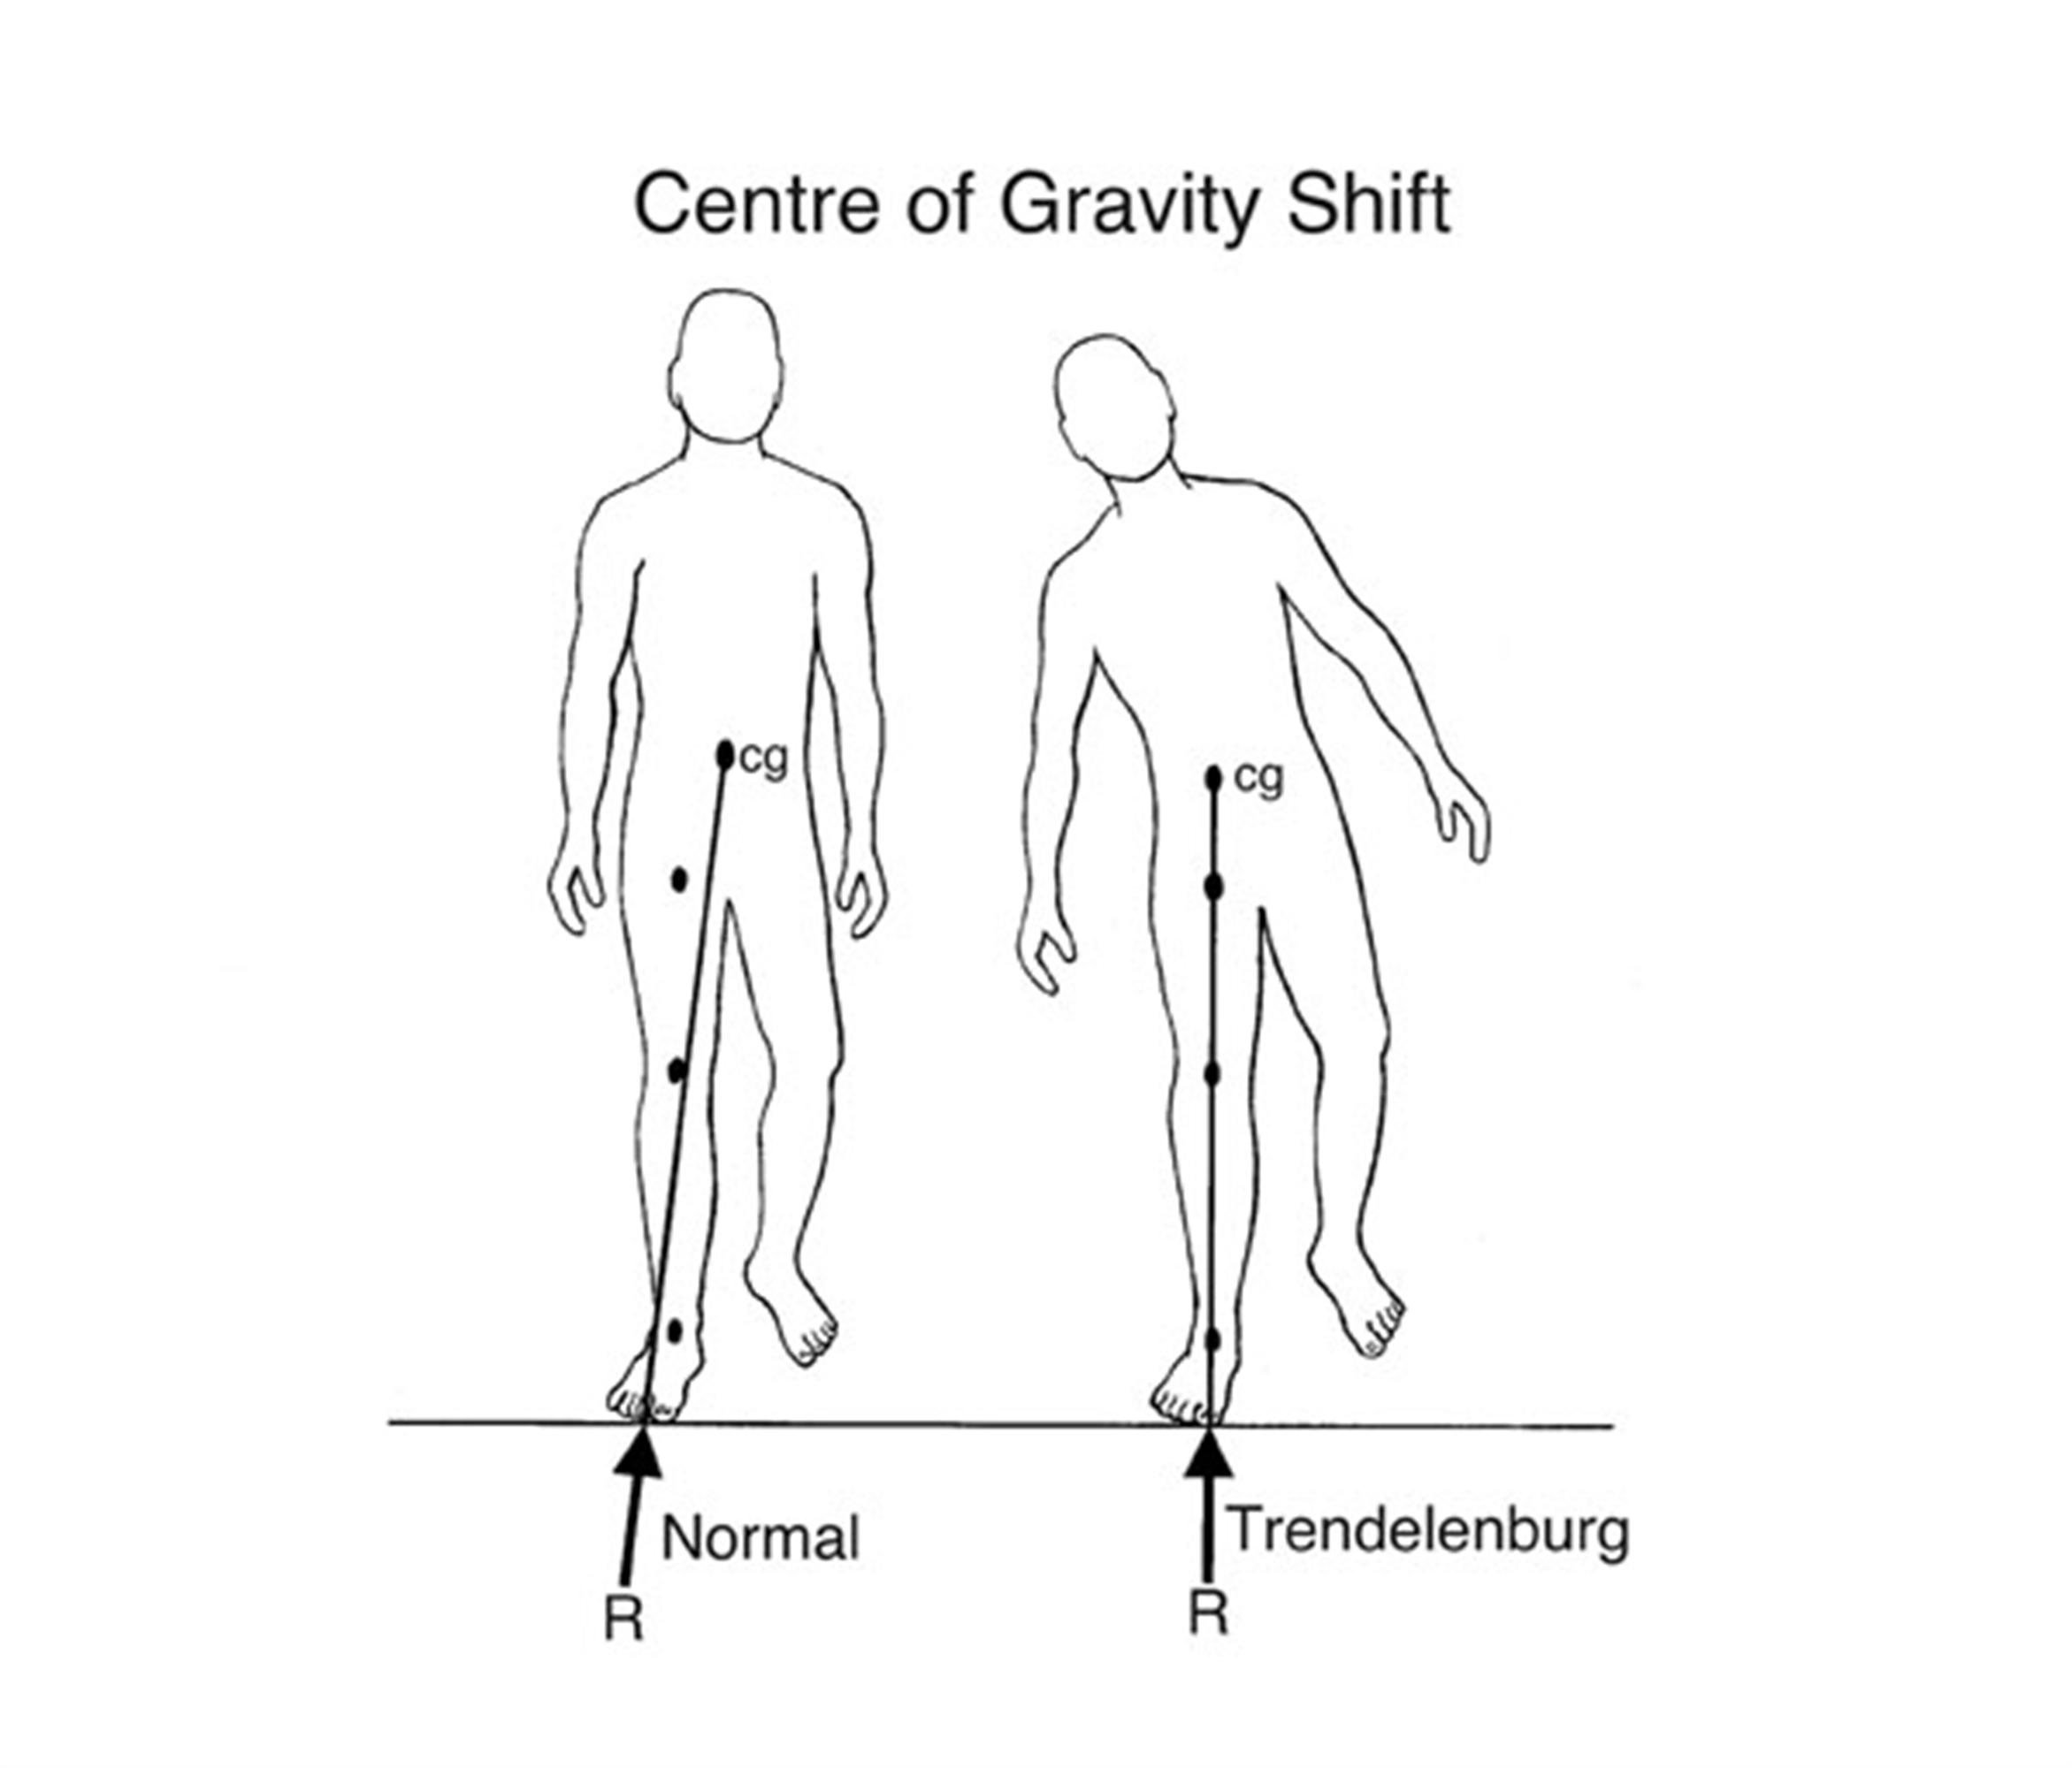
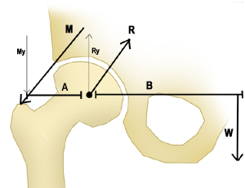
Biomechanics
Can take actions to decrease joint reaction force
Can also take actions to increase joint reaction force
https://www.orthobullets.com/recon/9064/hip-biomechanics

Slide 8

Recap

Slide 9
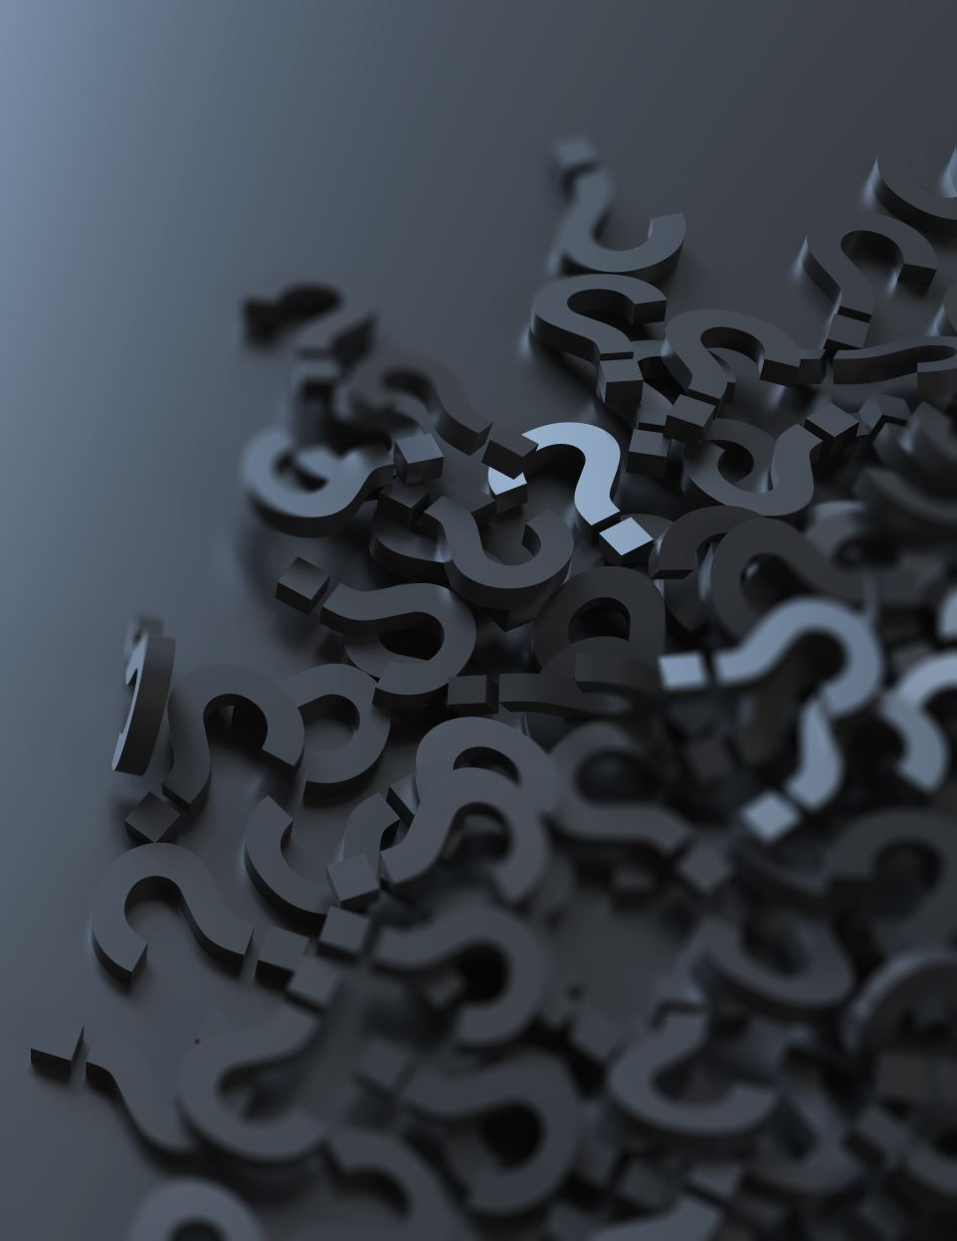
Questions?

